Slide 1
Places to live
Csomós Zoltán, Gadnai Gergő

Slide 2
• The quality of life in a village and in a town • Means of transport available • Services

Slide 3
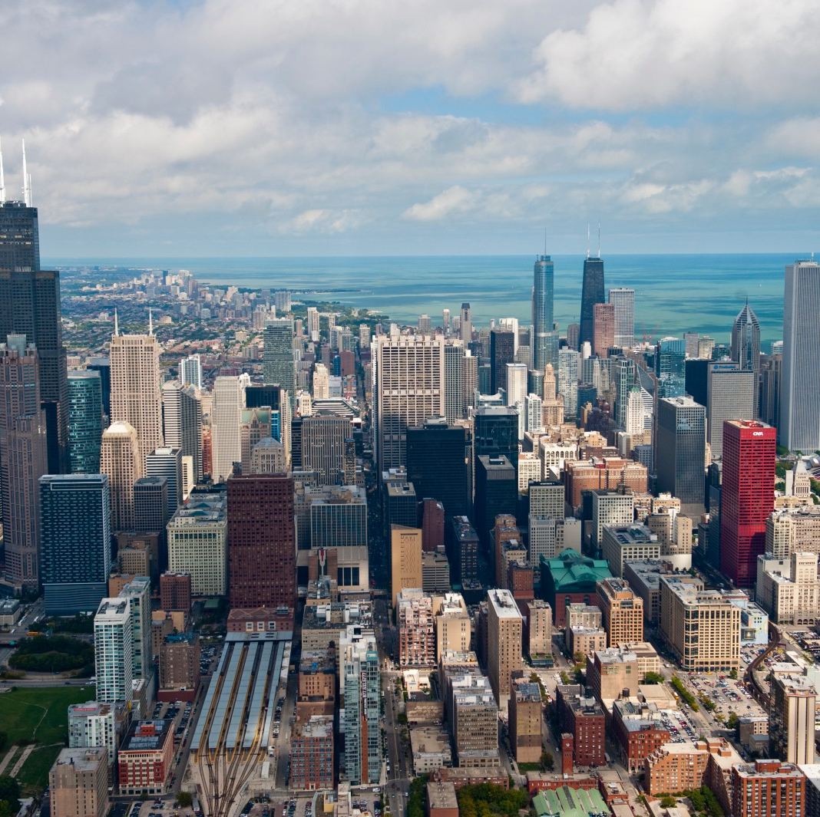
Quality of life in towns
Wider range of services
More job opportunities
Better Infrastructure
Noisier
Higher cost of living

Slide 4
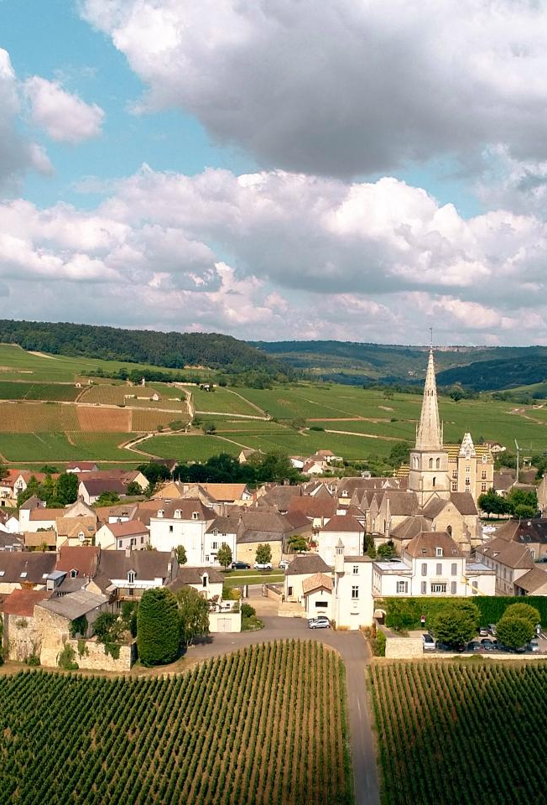
Quality of life in villages
Communities
Peaceful and quiet
Closer to nature
Lower cost of living

Slide 5
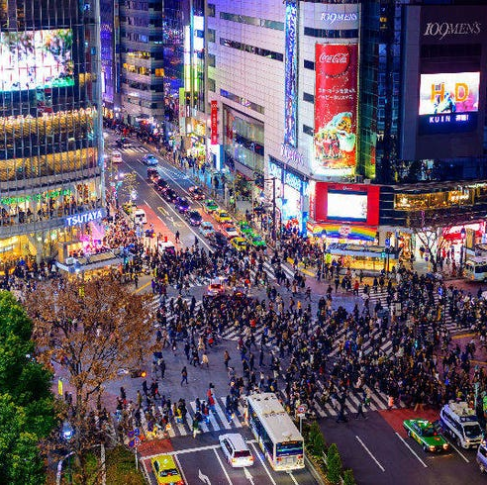
Means of transport in towns
Private cars, bicycles
Taxis
Public transport: bus, coach, trolley, subway, tram

Slide 6
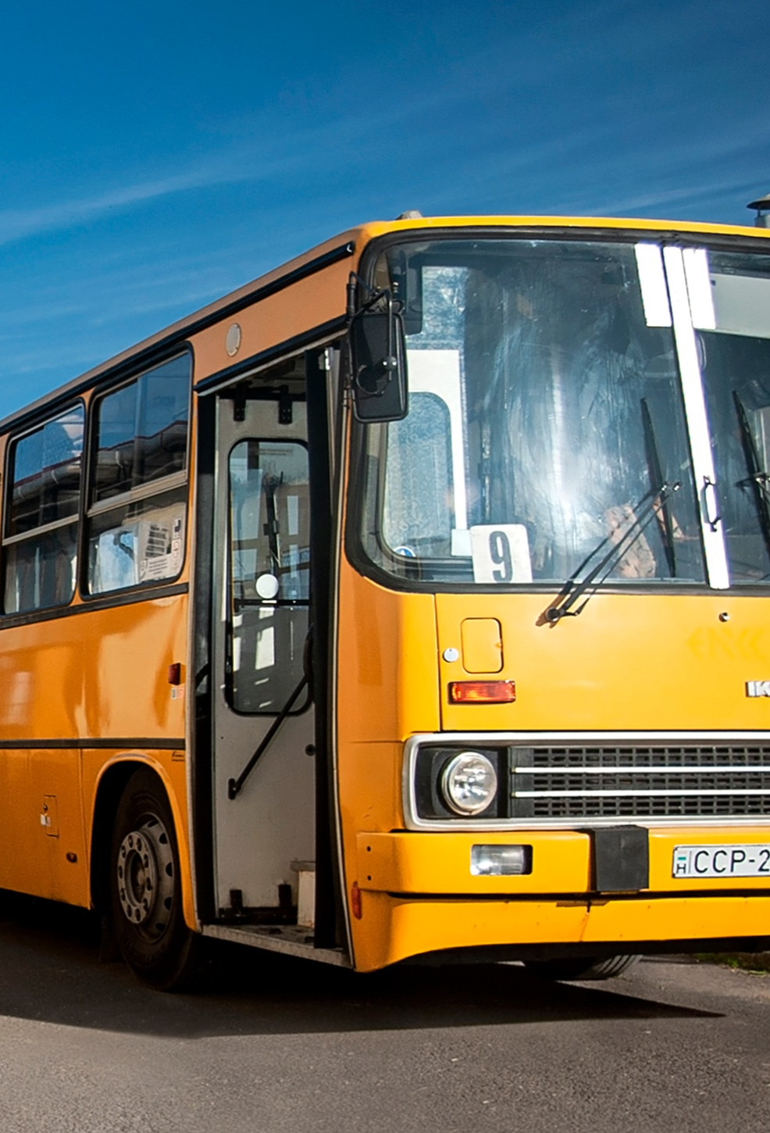
Means of transport in villages
Private cars, bicycles
Walking
Limited public transportation: bus, coach

Slide 7
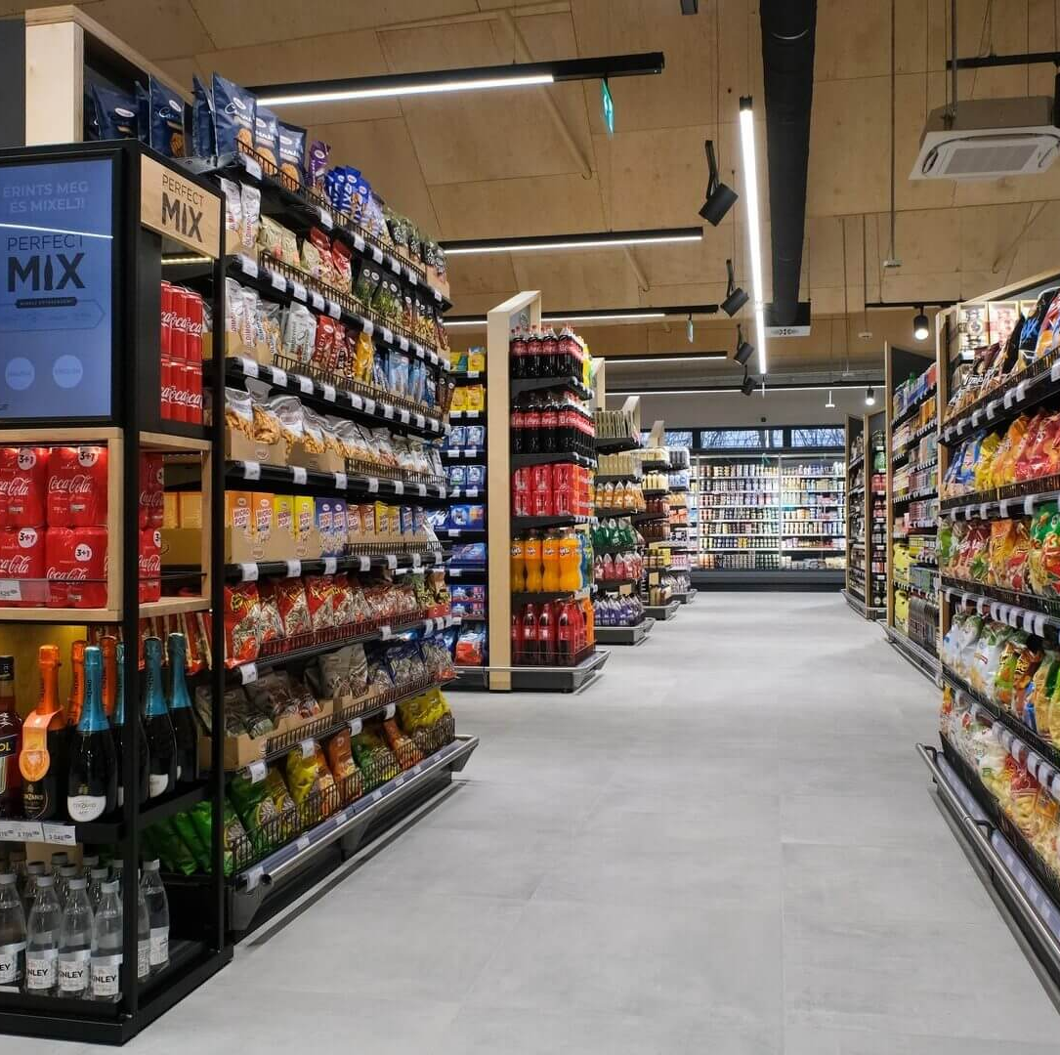
Services in towns
Professional Services: Healthcare Facilities, Banking Services
Educational Institutions: Universities
Supermarkets
Entertainment: cinemas, restaurants, nightlife

Slide 8
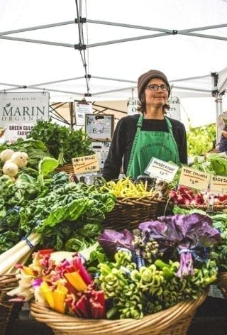
Services in villages
Basic Healthcare
Primary and Secondary schools
Local shops
Local gatherings, outdoor activities, traditional performances

Slide 9

Thank you for your attention!

Slide 10
Sources
3. linkedin.com
4. beaune-tourism.com
5. livejapan.com
6. magyarbusz.info
7. blog.myfitnesspal.com
8. justbudapest.com

